Slide 1
Quantum Dots
2023 Nobel Prize winning discovery !!

Slide 2
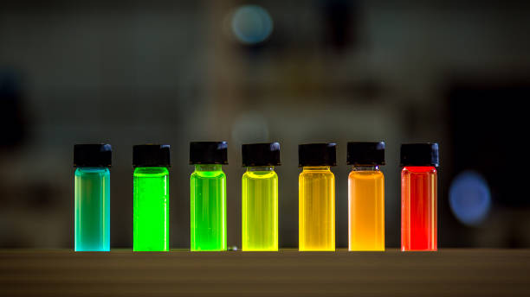
What are Quantum Dots ?:
Quantum dots (QDs) are man-made nanoscale crystals that exhibit unique optical and electronic properties, including the ability to transport electrons and emit light of various colors when exposed to light. Example: Cadmium selenide, copper chloride, lead sulfide and so on
They exhibit different colors based on their particle size.
The properties of a quantum dot are determined by size, shape, composition, and structure.
In the “nanoworld,” matter starts to be measured in millionths of a millimeter. At this level, strange phenomena start to occur called “quantum effects.”

Slide 3

Nobel Prize 2023 for Quantum Dots (Dr. Moungi Bawendi, Dr.Louis Brus, Dr. Alexei Ekimov - “for the discovery and synthesis of quantum dots”)

Slide 4
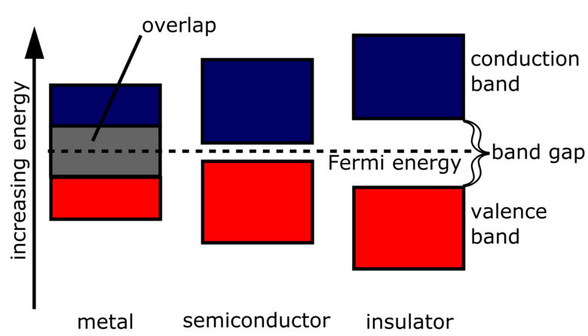
Properties of QDs:
Particle size and energy is inversely proportional
As size decreases, the distance between energy level increase, which is opposite in bulk materials
High photo stability
High quantum yield
Band gap and wavelength are inversely proportional
Quantum confinement effect

Slide 5
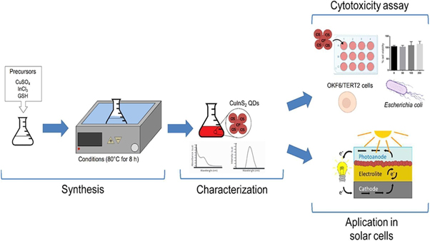
Techniques to synthesize:
Colloidal synthesis
Hydrothermal synthesis
Biomimetic synthesis

Slide 6
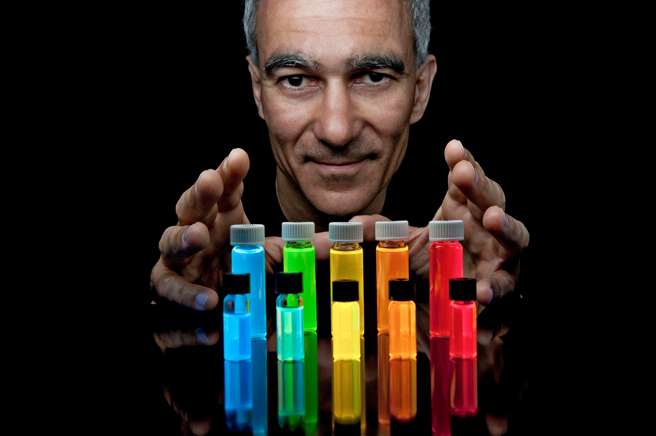
Applications of QD’s:
Rapid random-access memory (RRAM)
Neuromorphic devices
Memristors
Spintronics based electrical devices
Tumor imaging, bio imaging, protein structure in DNA etc.,
QD-LED screens/Television
Ultra fast lasers
Solar cells

